Slide 1
A Customer 360º View Applied To The Business Side of The Sporting World
Great Lakes Analytics in Sports Conference
July 13th, 2017
Presented by Shawn Gerou
@Fanalyticsports
Socializing analytics to the sporting world!
F
Terms of use: All materials/ideas displayed in the presentation belong to Fanalyticsports and its proprietors for private use. You may not distribute, modify, transmit, reuse, re-post or use the content without Fanalyticsports consent. Copyright © Fanalyticsports.

Slide 2
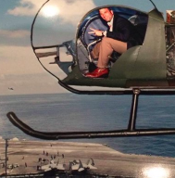
About Us
Fanalyticsports is a sports consulting firm focusing on providing business intelligence solutions and socializing the data driven approach to winning.
8+ years of experience in analytics working with Top Tier Consulting firms to drive business decisions.
Tableau Iron Viz Competitor 2017, “Traveling the Road to the Final Four”
Sports Journal of Economics Author of, “MLB Attendance Demand and Interleague Play”
Ticketing contract signed Dec. 2016, finalizing two more contracts for August 2017.
Shawn Gerou
CEO/Founder
F

Slide 3
A Customer 360º View Applied To The Business Side of The Sporting World
Current landscape and trends in Data and Analytics.
What is the Customer 360º View?
Examples and Use Cases.
F

Slide 4
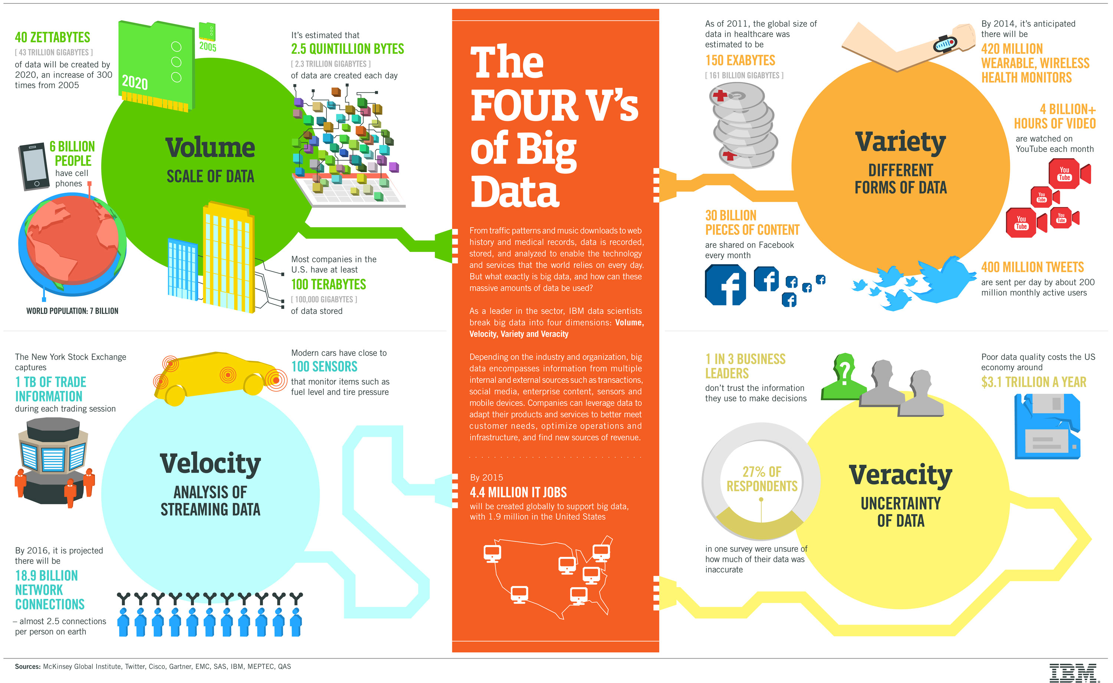
Trends and Current State
Twitter search on analytics and business intelligence brought back the following.
(https://github.com/fanalyticsports)
2.5 quintillion bytes of data is being created per day. (1 QT has 18 zeroes)
~500M tweets per day, 350 users upload Facebook photos.
Majority of this data is unstructured.
F
Notes:
20 years to read all the tweets per day.
2.5 B zip drives sized at 1GB each
40B Smartphones size of 64GB each
http://www.ibmbigdatahub.com/infographic/four-vs-big-data

Slide 5
A Customer 360º View Applied To The Business Side of The Sporting World
Current landscape and trends in Data and Analytics.
What is the Customer 360º View?
Examples and Use Cases.
F

Slide 6
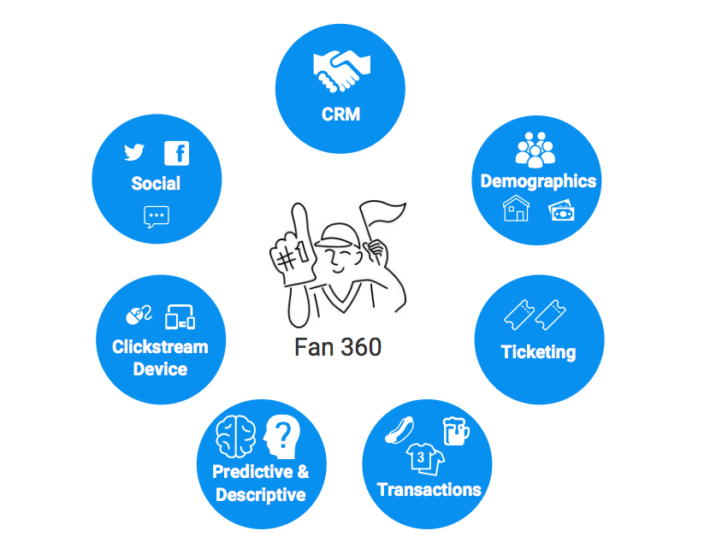
F

Slide 7
Things to Remember
Connecting the data dots not only helps lead business initiatives but improves analytics and reporting.
Relate your data points back to an entity and determine how best to determine that entities identity. (Player, Fan, Household, etc.)
Start small with key initiatives in mind.
Think outside the box. (SOW, LTV, Customer Journey ex.)
Build, Refine, and Test.
Connecting the dots
F

Slide 8
A Customer 360º View Applied To The Business Side of The Sporting World
Current landscape and trends in Data and Analytics.
What is the Customer 360º View?
Examples and Use Cases.
F

Slide 9
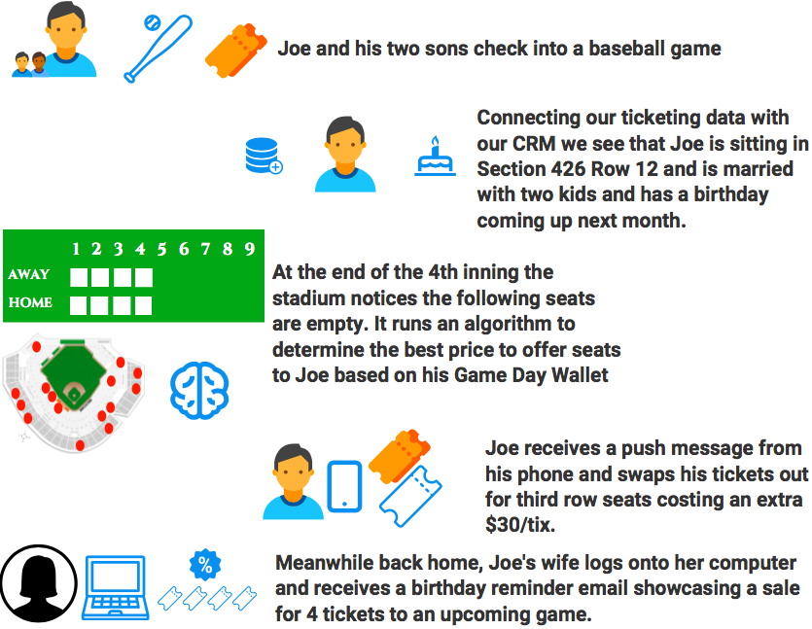
By connecting the dots and implementing an in-game ticket exchange we were able to increase revenue by +$1.3M dollars.
F
Notes:
*Estimated figures. We are still working through testing to determine best and adqeute pricing.

Slide 10
Determining a Game Day Wallet
What exactly do we mean by game day wallet?
Total spending ability of a fan for a given day. (Total daily spend)
Total attainable opportunity for given game. (Game is just one one area of spend)
Realistic attainable wallet by what the best customers spend. (Actual spend)
Actual Spend<=Daily Game Spend<=Total Daily Spend
~
Actual Spend
Daily Game Spend
~
Approaches to estimating wallet (Unobservable quantity)
Survey of customers to obtain values (Sampling issues, response bias)
Clustering approach to obtain best fans across ticket and game segments. (Assumes segmented best fans spend the majority of their wallet.)
Quantile Regression (Overfitting and bias possible.)
F

Slide 11

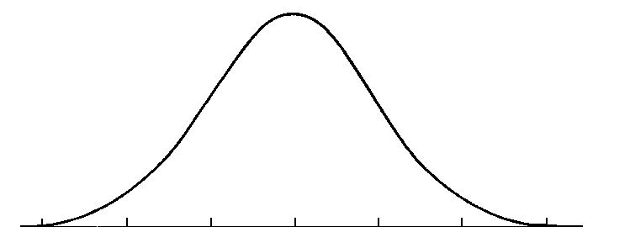
Modeling a Fan’s Wallet
Fan’s Wallet Algo
K-Means for fitting the best fans by segment.
Evaluate clusters by segment for fit and check distribution of variables.
Model Actual Spend by segment by using the best fans for each group.
Apply Model scores to every fan within it’s segment to create a Wallet score for each fan.
F_{w} = c+ β₁*GameSeg+ β₂*TicketSeg+ β₃*DOW +β₄*PriorSpend + β₅*Age +β₆ *Age²+ β₇*INC+ β₈*INC²+ β₉*Consess+ ….........+ Error
F
Notes:
http://www.onmyphd.com/?p=k-means.clustering

Slide 12
Fan 360 Applied to Other Examples
LTV applied to Sponsorships.
Abandoned Cart (Product/Ticketing)
Personalized concession/vendor offers.
Journey Mapping. (Outreach programs for New and Existing Fans)
Dynamic Ticket Pricing Optimization.
Optimized channel marketing.
F

Slide 13
Questions?
@fanalyticsports
shawn.gerou@fanalyticsports.com
www.fanalyticsports.com
F

